Slide 1

Software Engineering CSC648/848

Slide 2

Coding STYLE
Henry VILLAR
and Coding Best Practices

Slide 3
Objective
Define Coding Style
Analyze Benefits
Best Practices for:
Formatting
Style
Documentation
Coding for security
References to use (often language specific) – note: tools/standards change in time
How to enforce coding style
Notes:
Top 10 languages 2022:
https://www.geeksforgeeks.org/top-10-programming-languages-to-learn-in-2022/
Building faster with Codex
https://youtu.be/wSAkqlzSZyw?si=W2fISC_XhJCY6Ola

Slide 4
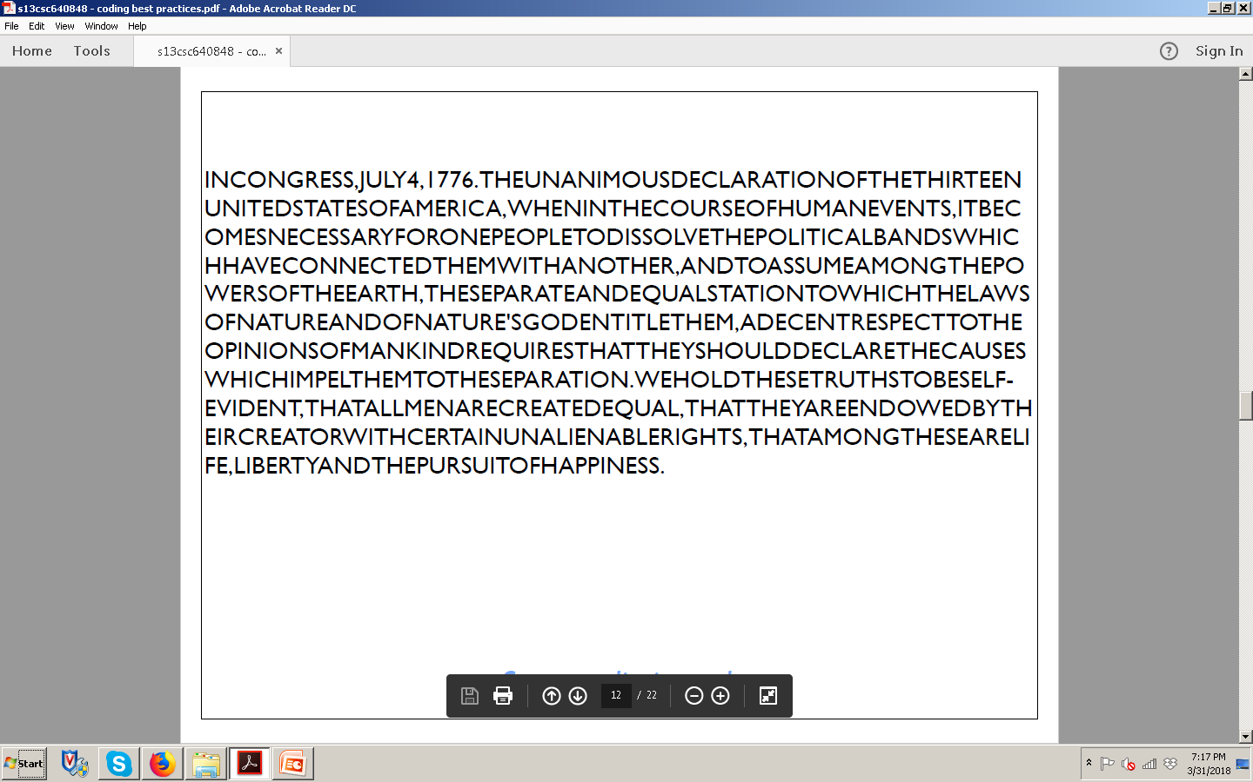
What is this about?

Slide 5
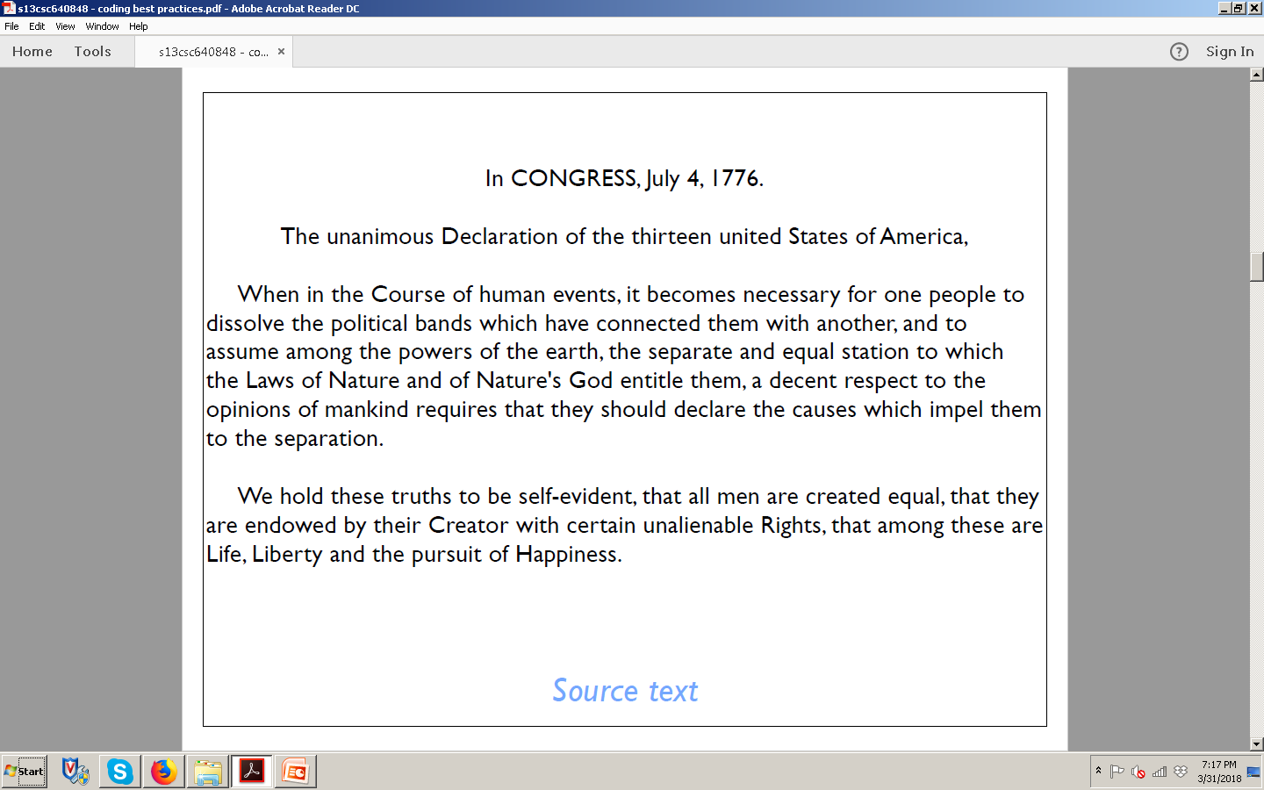
Now you know – so style and formatting helps

Slide 6
Why coding style?
Important
Most time in SW lifecycle is spend on the maintenance phase
This is mostly done by HUMANS ➔ code readability helps
Most time you maintain code of somebody else (and not easy to contact)
Also: Ask yourself if you understand the code YOU wrote months ago…
What is it? Programming style, also known as code style, is a set of rules or guidelines used when writing the source code for a computer program. It is often claimed that following a particular programming style will help programmers read and understand source code conforming to the style, and help to avoid introducing errors. Wikipedia

Slide 7
SW Engineering Process Components (Lifecycle)
1. Requirements and Specifications
2. Design and Implementation
3. Validation
4. Maintenance and Evolution
Notes:
There are several basic components present in all SW Engineering methodologies:
SW Requirements and Specification: functionality, constraints, look and feel, GUI, performance
SW Design and Implementation
SW Validation: formal, test plans, QA
SW Maintenance and Evolution: ongoing changes (and fixes) to meet customer needs
These components are applied in different way and order (linear, iterative, spiral...) depending on chosen SW Engineering methodology or models (I.e. waterfall, extreme, agile etc.)‏

Slide 8
SW Engineering Process Components (Lifecycle)
1. Requirements and Specifications
2. Design and Implementation
3. Validation
4. Maintenance and Evolution
Notes:
There are several basic components present in all SW Engineering methodologies:
SW Requirements and Specification: functionality, constraints, look and feel, GUI, performance
SW Design and Implementation
SW Validation: formal, test plans, QA
SW Maintenance and Evolution: ongoing changes (and fixes) to meet customer needs
These components are applied in different way and order (linear, iterative, spiral...) depending on chosen SW Engineering methodology or models (I.e. waterfall, extreme, agile etc.)‏

Slide 9
Elements of coding style
Important
Naming Conventions (variables, functions, classes)
File Naming and Organization
Code Formatting
Code Comments
Documentation
Coding practices
Best practices in how to code e.g. for security

Slide 10
Benefits of good coding style
Important
Easier maintenance (big thing)
Easier testing
Easier optimization
Easier portability
Why coding style and benefits
https://www.multidots.com/importance-of-code-quality-and-coding-standard-in-software-development/
Notes:
MAINTENANCE
Software maintenance in software engineering is the modification of a software product after delivery to correct faults, to improve performance or other attributes.
https://en.wikipedia.org/wiki/Software_maintenance
TESTING
Software testing is an investigation conducted to provide stakeholders with information about the quality of the software product or service under test
https://en.wikipedia.org/wiki/Software_testing
OPTIMIZATION
In computer science, program optimization, code optimization, or software optimization is the process of modifying a software system to make some aspect of it work more efficiently or use fewer resources.
https://en.wikipedia.org/wiki/Program_optimization
PORTABILITY
Portability in high-level computer programming is the usability of the same software in different environments
https://en.wikipedia.org/wiki/Software_portability

Slide 11
Specific coding styles….
Important
Often depend on languages
Ton of good coding styles adopted and became de-facto standard
Teams have to agree on coding style consistent with the company policy and best practices
Standards change – follow them
Enforce coding style by coding review
(No coding style used ➔ no submission!!!)
CSC 648-848:
Agree on a coding style after end of M2
Enforce it
Will be checked and graded for

Slide 12
Coding styles for Languages (examples)
Java coding style
http://www.oracle.com/technetwork/java/codeconventions-150003.pdf
https://github.com/twitter/commons/blob/master/src/java/com/twitter/common/styleguide.md
PHP coding style
https://pear.php.net/manual/en/standards.php
Python coding style
https://www.python.org/dev/peps/pep-0008/
https://google.github.io/styleguide/pyguide.html
C++ coding style
https://google.github.io/styleguide/cppguide.html
HTML coding styles and checkers
https://www.w3schools.com/html/html5_syntax.asp
https://google.github.io/styleguide/htmlcssguide.html
https://www.smashingmagazine.com/2008/11/12-principles-for-keeping-your-code-clean/
Notes:
JavaScript
https://www.w3schools.com/js/js_conventions.asp

Slide 13
Naming conventions (examples)
C++ (Google)
https://google.github.io/styleguide/cppguide.html#Naming
Java (Google)
https://google.github.io/styleguide/javaguide.html#s5-naming
Python (Google)
https://google.github.io/styleguide/pyguide.html#Naming

Slide 14
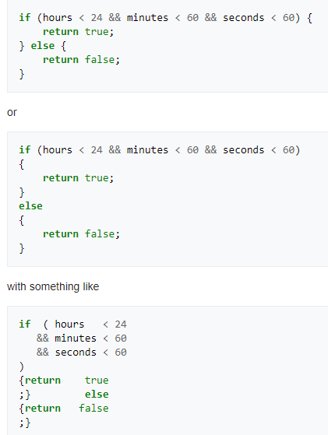
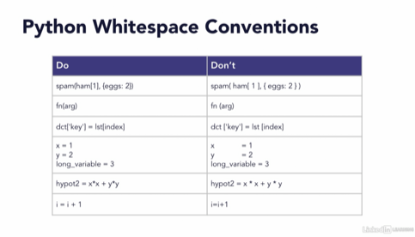

Code Style (Indentation, White Space, Capitalization, Style and Spelling, Use & Style of Comments)
Notes:
Indentation
White Space
Capitalization
Style and Spelling
Use & Style of Comments

Slide 15
Coding style for comments and documentation (examples)
Comments can be for
Headers (of classes, modules, functions) – basic information like purpose/function, methods, attributes, author, date
In code
Headers
https://pear.php.net/manual/en/standards.header.php
https://en.wikibooks.org/wiki/PHP_Programming/Coding_Standards#Header_Comment_Blocks
General (Java, Python, C++)
http://www.oracle.com/technetwork/java/javase/documentation/codeconventions-141999.html
https://google.github.io/styleguide/pyguide.html#Comments
https://legacy.python.org/dev/peps/pep-0008/#comments
https://google.github.io/styleguide/cppguide.html#Comments

Slide 16
Tools for automatic documentation generation (examples)
Idea:
Document code in a certain way
Run tool to automatically generate documentation
General overview
https://en.wikipedia.org/wiki/Comparison_of_documentation_generators
Doxygen – automatic doc. generation from source code
About http://www.doxygen.nl/index.html
How to document your code so doxygen can automatically create the documentation http://www.doxygen.nl/manual/docblocks.html
Doxygen demo: https://youtu.be/44Ja2X_fzv4

Slide 17
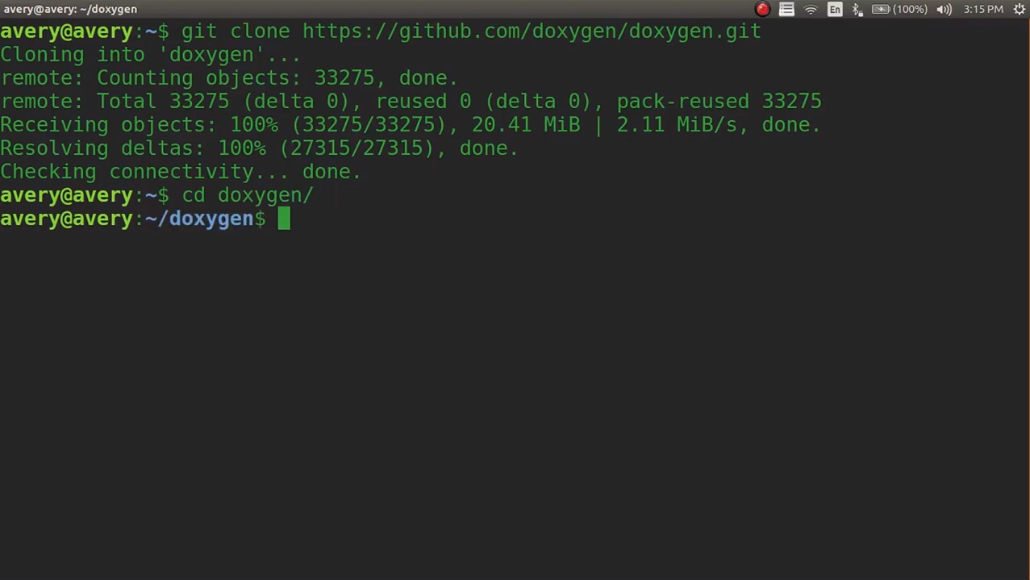
Doxygen - Documentation For Your Programs (Demo)
Notes:
Doxygen - Documentation For Your Programs - Installing, Setting Up, And Running Tutorial
https://youtu.be/44Ja2X_fzv4

Slide 18
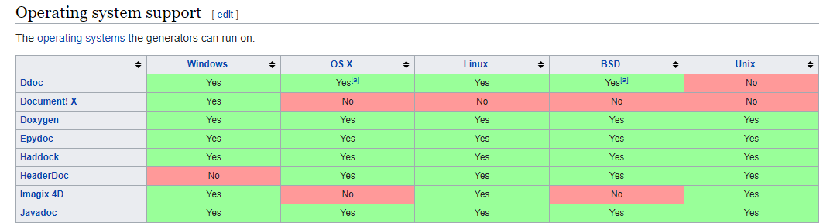
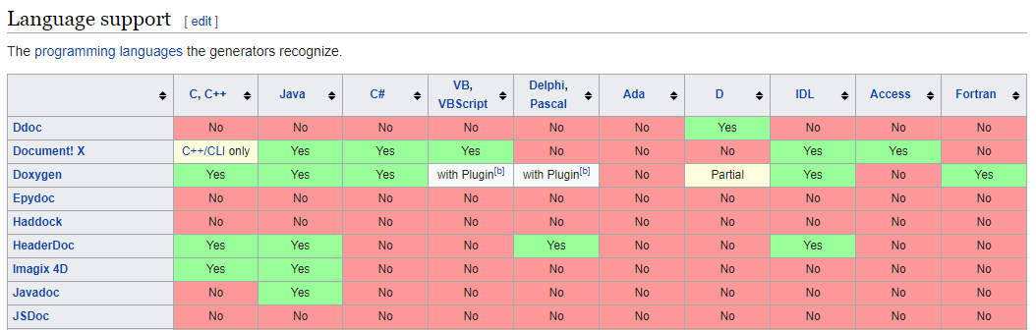
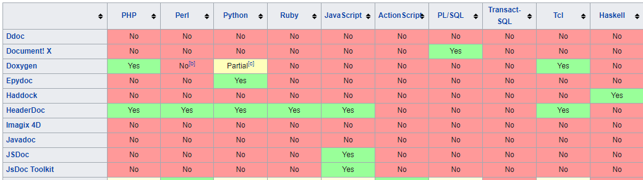

Slide 19
Github documentation and comments
Important
Good comments are critical for being able to leverage github
Think about looking for update on specific type of issue – search comments to find it quickly
Research shows (including ours) that teams who do better github comments do better code and SW
https://github.com/erlang/otp/wiki/writing-good-commit-messages

Slide 20
Best Practices Coding Style for Security
Important
Ensure and enforce proper coding practices – use code and architecture reviews
Check inputs and allow only valid ones
Ensure proper transmission and management of passwords
Use secure internet protocols
Check buffer size – make sure no attack can be done by sending longer data streams
Prevent injection of SQL code into the forms
Check uploaded content for executables
Virus check all uploaded content

Slide 21
Forms and Inputs – one of the KEY security issue on the WWW
Cross site scripting, SQL and other injections – most done or first attempted via forms input
Hence, follow best SE practices for validating and checking all form inputs ➔ plenty of tools and coder and APIs available e.g.
https://www.securecoding.cert.org/confluence/display/seccode/SEI+CERT+Coding+Standards
go to java and check rule 00
https://wiki.sei.cmu.edu/confluence/pages/viewpage.action?pageId=88487865
https://1000hz.github.io/bootstrap-validator/

Slide 22
Coding in the AI era ~Henry’s POV
From Implementation to AI-Augmented Engineering & Orchestration
Working with AI coding assistants
Architect AI-integrated systems
Evaluate AI outputs critically
Design for security in AI-driven environments
Orchestrate hybrid human-AI workflows
Shift: Engineer as Orchestrator
From coder -> system thinker
Implementer -> decision architect
Syntax mastery -> problem framing mastery
Human-in-the-loop engineering
Code Review
Secure Coding
System Design
Governance, Ethics & Professional Responsibility
Engineering Productivity & Cognitive Offloading
When AI enhances thinking
When AI weakens thinking
Maintaining core algorithmic skills
Avoiding “AI dependency collapse”
Notes:
OpenAI Super Bowl 2026 | Codex | You Can Just Build Things
https://youtu.be/aCN9iCXNJqQ?si=tr1R6jY1IVeE2dOu
Building faster with Codex
https://youtu.be/wSAkqlzSZyw?si=W2fISC_XhJCY6Ola

Slide 23
Team Project Time
Work on M2 More Detailed Requirements, Specs, Architecture, UI mock-ups and Vertical SW prototype. Two goals:
More detailed design - Milestone 2 document: prioritize requirements; design high level UI mockups and storyboards; design high level DB organization, and practice UML. (one per team, submitted similarly like Milestone 1). Use as much space as you need, but the expected length is about 20-25 pages. You must submit all sections.
Functional Requirements – prioritized
UI Mockups and Storyboards (high level only)
High level Architecture, Database Organization
High Level UML Diagrams
Identify actual key risks for your project at this time
Project management
Vertical SW Prototype: Develop first simple bare-bones prototype (from DB to browser) to test the infrastructure, educate the team, resolve technical issues and also serve as basis of further development (must run on the deployment server). (one per team) to be reviewed in class and also by Class CTO (off-line)
Notes:
Horizontal and vertical prototypes are sometimes used during the analysis and design phases of application development. They are useful for requirements elaboration and visualization, but can present some pitfalls. As long as analysts and teams are aware of the pitfalls to avoid, the pros of using prototypes generally far outweigh the cons. The type of prototype that should be used (horizontal prototype versus vertical prototype) depends on the specific goals of the team and the stage within the analysis and design process.
Horizontal Prototypes
Horizontal prototypes are most often used during the early stages of analysis. They give a broad view of the application including sample screens, menus, buttons, pop-ups and sample reports that reflect the current requirements. While the screens are superficially interactive, buttons and features will have little or no processing behind them. The may navigate a user to another screen, give and alert, or show a sample report with dummy data, but the internal functions are not fully implemented.
Horizontal prototypes reflect the breadth of the system without drilling down into too much detail. They are helpful for understanding the range of abilities across a system and how feature sets will be brought together. They are useful for presenting ideas to stakeholders, facilitating requirements discussions, and gaining buy-in on requirements and design decisions.
Vertical prototype
Vertical prototypes are used in the later stages of analysis and design to drill down and elaborate on specific features or functions. Vertical prototypes are more technical in nature, connect to databases with real data, interface with existing sub-systems, and reflect the nearly-exact functioning of key features. They are most appropriate when complex features of a system are poorly-understood and are useful in demonstrating that a requirement or set of requirements is technically feasible. Vertical prototypes do not attempt to detail out the entire breath of the application, but focus on implementing a specific feature or feature set in a more complete manner. They demonstrate to the stakeholders that the application works although it might not be fully tuned.

Slide 24
M2
MILESTONE 2. More Detailed Document. Make sure to read the instructions.
Functional Requirements – prioritized
Use M1 and reference numbers
Prioritize (1 must have, 2 desired, 3 Opportunistic)
UI Mockups and Storyboards (high level only).
High level Architecture, Database Organization
High Level UML Diagrams.
Use UML to describe your class diagrams classes of core functionality.
Identify actual key risks for your project at this time.
Brainstorm with your team and list your identified risks (skills, schedule, technical, etc.)
Project Management
Assign tasks and describe how your team is working together.
Notes:
UI Mockups and Storyboards (high level only).
Remember slide #70 of Class 2 slides. Practically, based on your use cases, you make a mockup of each of them graphically and describe the sequence. For instance [1] The register page mockup --> [2] Upload picture GUI mockup -->[3] Post to sell mockup...etc.
High level Architecture, Database Organization
Some of the teams already did some database org in M1, from those who don’t, you need for M2. Remember class 4 slide 28 MVC and other Architecture pattern, use those and align them with the instructions (media Storage, Search, APIs, etc.)

Slide 25
M2 – Vertical Prototype
Vertical prototype [1] shall allow one to enter a search term on test home page (simple home page used to test vertical prototype), [2] then get a response form the DB and render it back on the browser in a simple test result page.
UI for the test home page can be a simple one containing
Class, section and team identification
One free text entry field (this text is then used in SQL %LIKE search – check architecture)
One pull down for 2-3 search parameter (search category like student or professional, major, roommate gender, room rent, etc.) – this is exercised using simple SQL filter – see architecture slides
The test result page needs to display search results including images and later their thumbnails as well as profile videos (if implemented) in any reasonable layout (the goal here is to make sure you can access and display items and NOT the ultimate UI). Thumbnails need to be computed automatically using some open source thumbnail generation SW – you can do thumbnails later after you figure out the basic way to show imageThe DB can have only a few items. The items in the DB shall be encoded with full schema as it is defined by now in M2 document
Make sure that if user hits “search” or related button, and does not enter any parameters, you display full list of items from the DB
Notes:
UI for the test home page can be a simple one containing o Class, section and team identification
o One free text entry field (this text is then used in SQL %LIKE search – check architecture slides)
o One pull down for 2-3 search parameter (like main search category like student type, major, demographics, etc.) – this is exercised using simple SQL filter – see architecture slides

Slide 26
Thank You

